Slide 1
Summer Project with LBNL
Machine Learning Enabled Multiscale Modeling of Mechanical Deformation of Metal-Matrix-Nanocomposites (MMNC)

Slide 2
Outline
Problem Background
Scope of Research
Literature Review
Preliminary Work
Model Creation
Data Generation/Molecular Dynamics Simulation
Database creation
Labelling Defect Mode
Training Machine Learning Model
Defect Mode Classification
Stress Regression Model
Implementation of Trained Model in Continuum Finite Element
Key Questions and Challenges

Slide 3
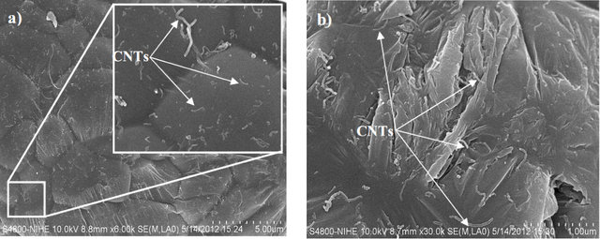
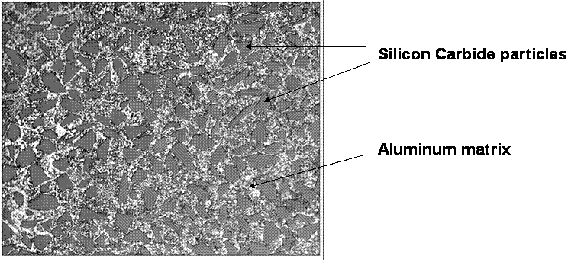
1.0 Problem Background
Metal Matrix Nanocomposites(MMNC)
Example: Al-CNT, Al-SiC, Al-Al2O3 etc
Enhanced Mechanical Properties compared to Micro-composites and Unreinforced Matrix
The reason for this enhancement is attributed to the very high nanoparticle-matrix Interface to volume ratio in these MMNCs
A Multiscale modeling technique is needed that can relate these nanoscale structures with their corresponding macroscale properties

Slide 4
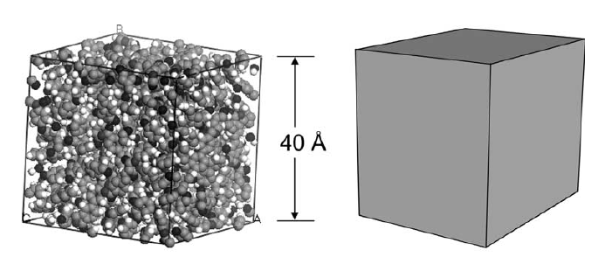
1.0 Problem Background(2)
Multiscale Modeling
Conventional Hierarchical Multiscale Modeling:
Nanoscale Atomic Model ----> Homogenization---> Equivalent-Continuum-Model(RVE)-->Macroscale Simulation
Mechanical Propertiy of a material is controlled by its most dominant defect, for MMNc the most dominant defect is the nanoparticle and the interface between the nanoparticle and matrix
Conventional homogenization techniques has no way to Incorporate nanoparticle-matrix Interface Mechanisms into the model for the MMNCs
A Possible Remedy, Machine Learning Enhanced Homogenization

Slide 5
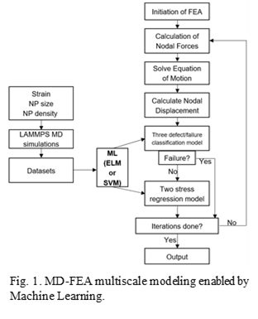
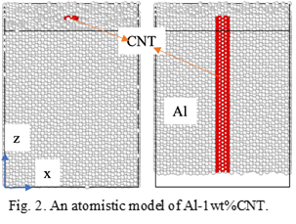
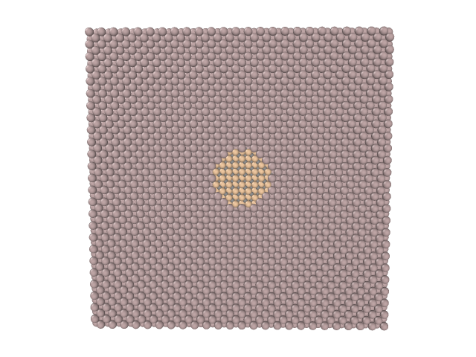
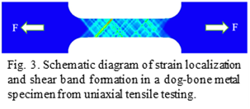
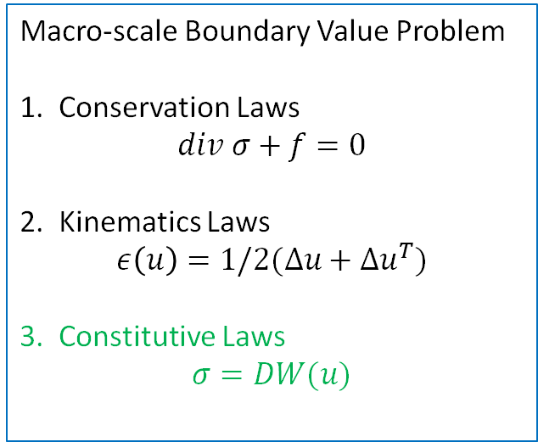
2.0 Scope of Research
ML-Based Multiscale Modeling
(ML-enhanced Homogenization)
Macro-scale Boundary Value Problem
1. Conservation Laws
$$div σ+f=0$$
2. Kinematics Laws
$$ε\left(u\right)=1/2(Δu+Δu^{T})$$
3. Constitutive Laws
$$σ=DW(u)$$

Slide 6
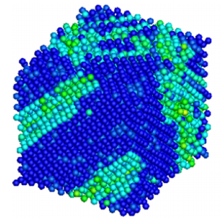
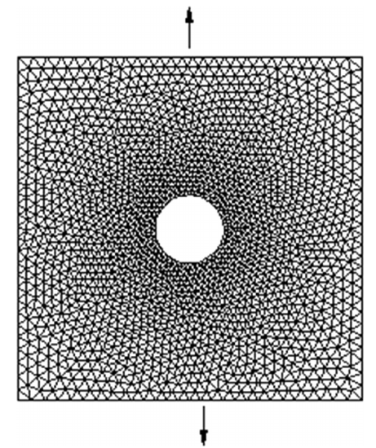
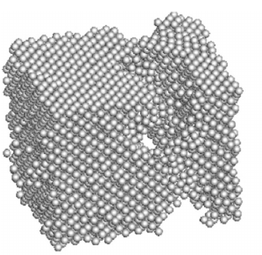
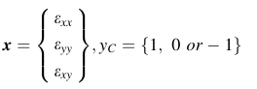
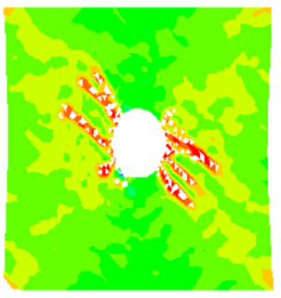
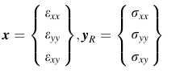
3.0 Literature Review
Machine Learning Enhanced Homogenization
Defect Classification Model
Stress Regression Model
Nano-scale(MD)
Macroscale(FEM)
Xiao S, Hu R, Li Z, Attarian S, Björk K M and Lendasse, A 2020 A machine-learning-enhanced hierarchical multiscale method for bridging from molecular dynamics to continua Neural Comput. Appl. 32 14359–73

Slide 7
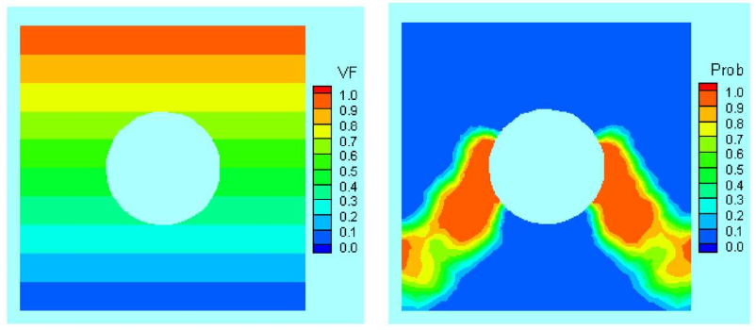
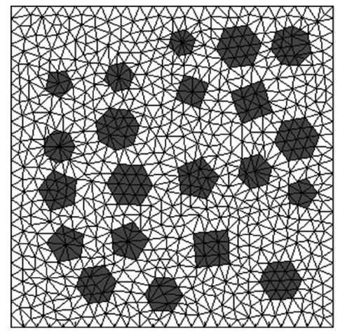
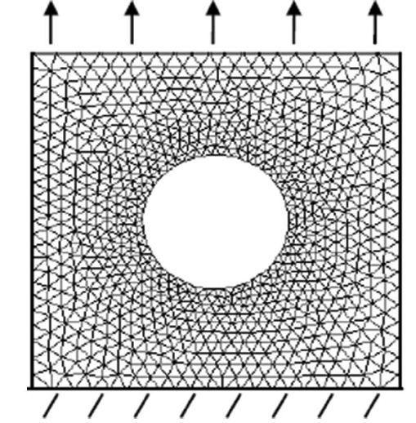
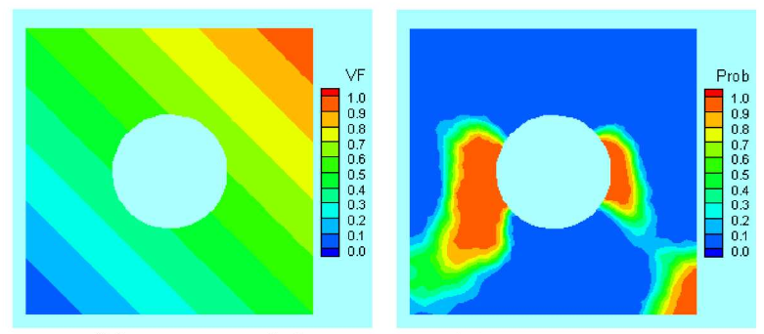
3.0 Literature Review(2)
Spatially Tailored Material(SPT)/
Functionally Graded Materials(FGM)
Microscale
Macroscale
Additional Feature---> Volume Fraction(VF) of Secondary Phase
Xiao S,Phillip Deierling, Saimak Attarian, Ahmed El Tuhami, Machine Learning in multiscale modeling of Spatially Tailored Materails, 2021, Composite and Structures, 249 106511

Slide 8
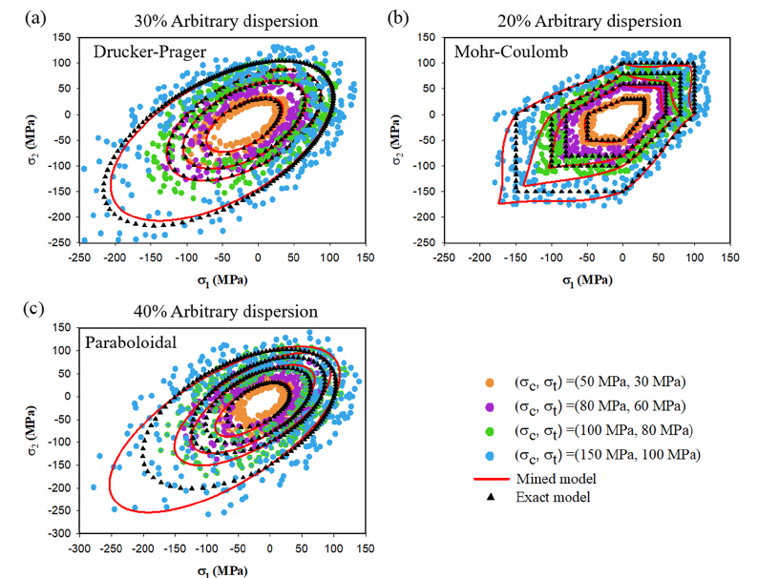
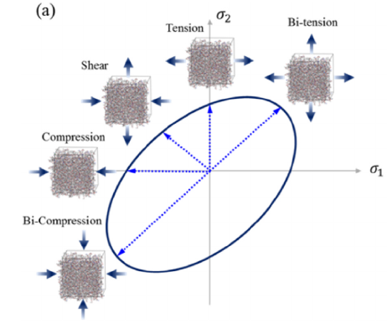
3.0 Literature Review(3)
Hyungbum Park, Maenghyo Cho, Multiscale constitutive model using data–driven yield function, Composites Part B: Engineering, Volume 216,2021, 108831, ISSN 1359-8368

Slide 9
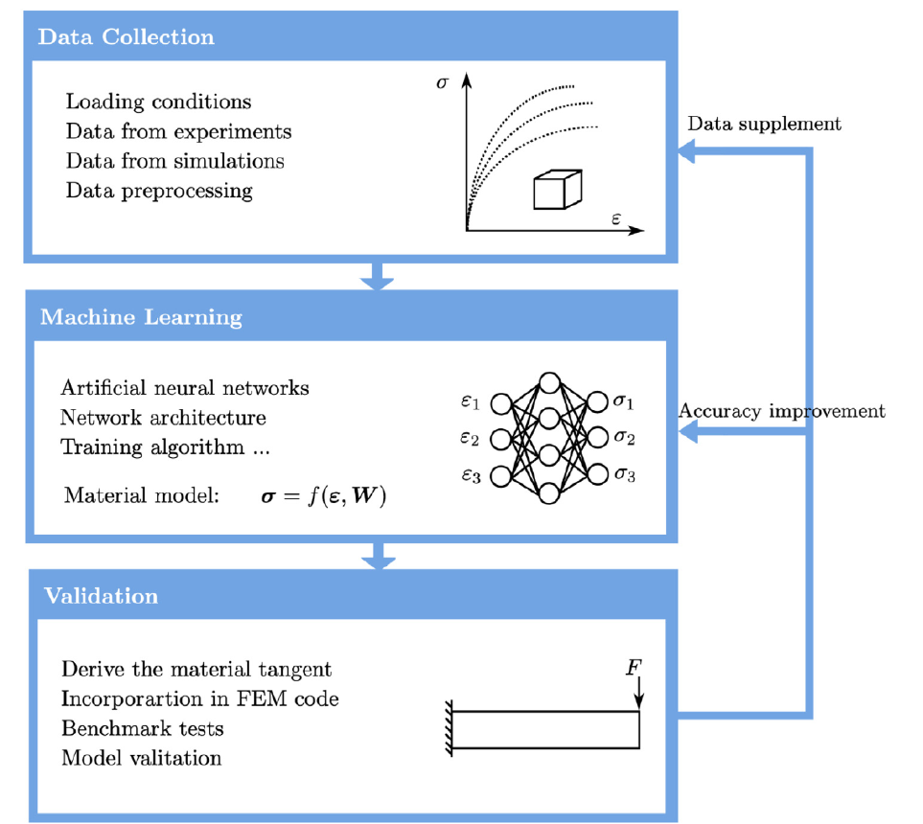
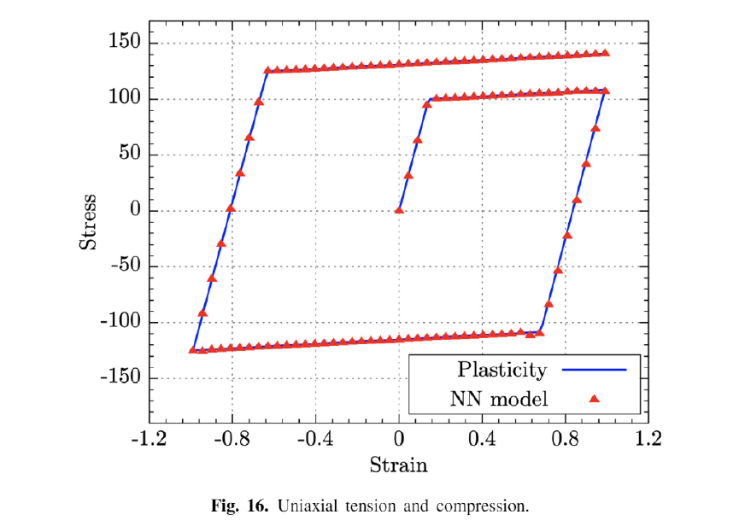
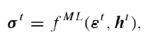
3.0 Literature Review(4)
History Dependent Feature
h^{t}
Dengpeng Huang, Jan Niklas Fuhg, Christian Weißenfels, Peter Wriggers,A machine learning based plasticity model using proper orthogonal decomposition, Computer Methods in Applied Mechanics and Engineering, Volume 365, 2020, 113008

Slide 10
4.0 Preliminary Work
Software Used:
Atomistic Model Generation --------> LAMMPS and Atomsk
Molecular Dynamics Simulation ----> LAMMPS
Machine Learning and Data Science -------> Tensorflow, Scikit-learn, Pandas, JupyterLab and Jupyter Notebook
Finite Element Model -----------> Code Aster (Through MFront Interface)
Visualization ------> OVITO and Paravis

Slide 11
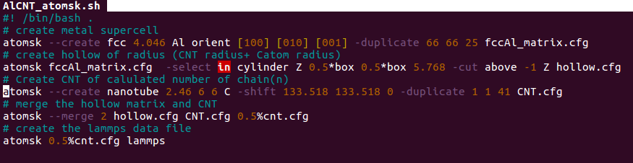
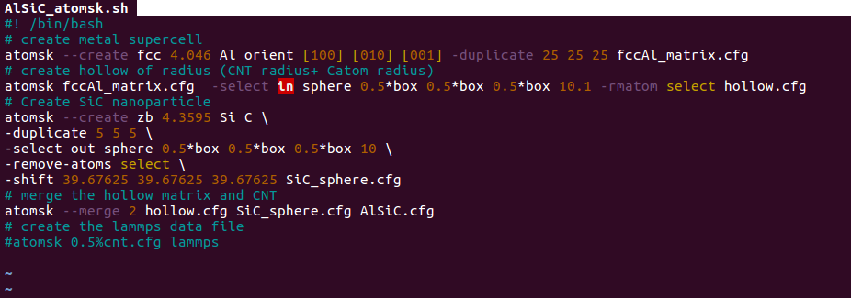
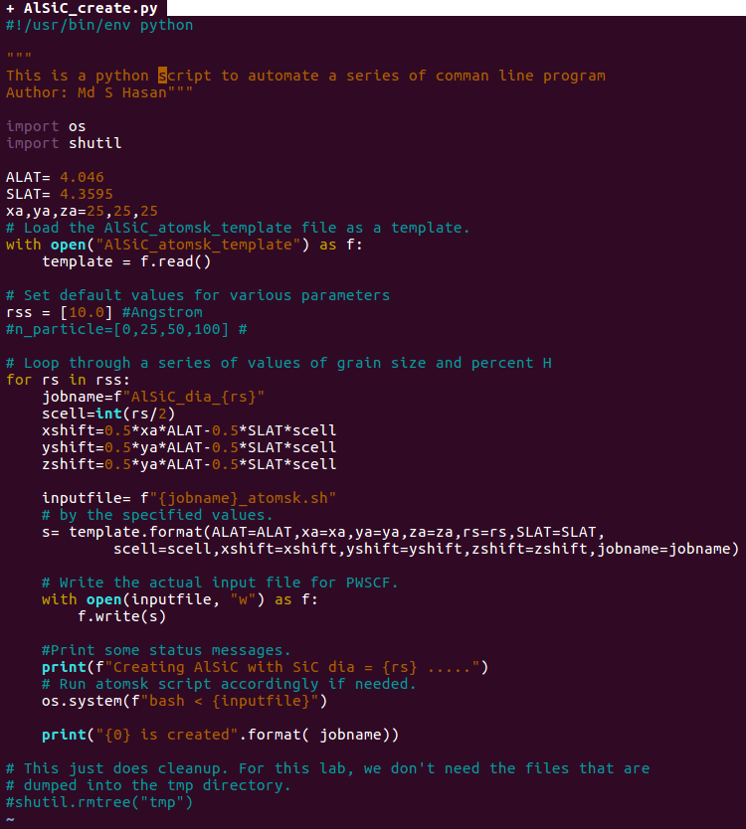
4.1 Atomistic Model Creation
Atomsk Script for creating Al-CNT atomistic model
AtomskScript for creating Al-SiC atomistic model
Python Script for automatically creating nanocomposite model of varying particle size

Slide 12
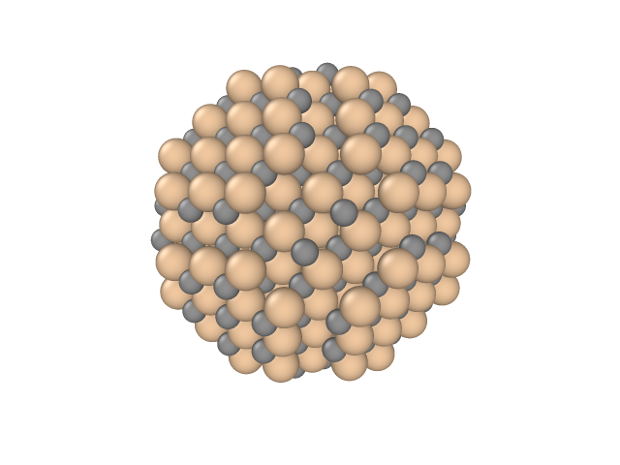
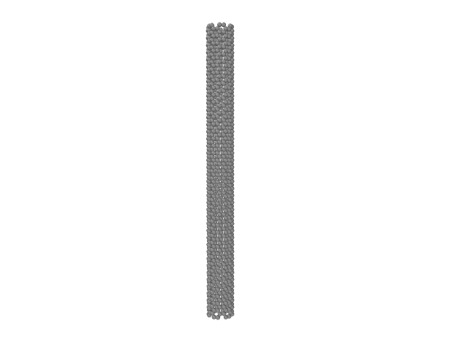
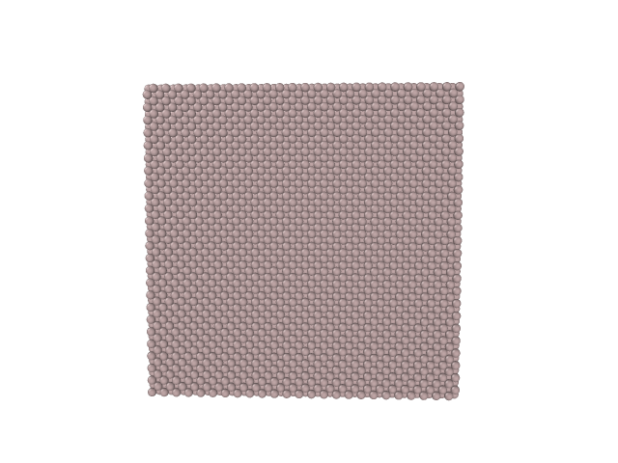
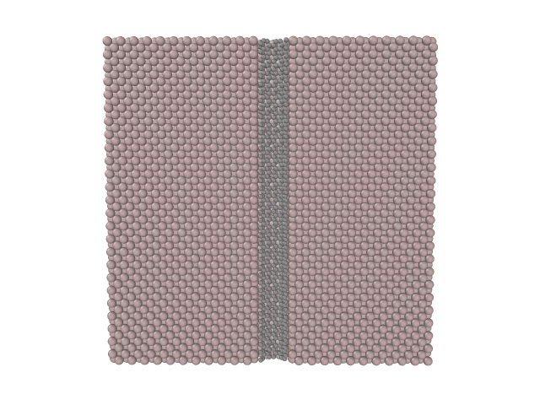
4.1 Atomistic Model Creation(2)
Resulting Atomistic Models
Silicon Carbide(SiC)
Carbon NanoTube(CNT)
Pure Aluminum
Al-SiC MMNC
Al-CNT MMNC

Slide 13
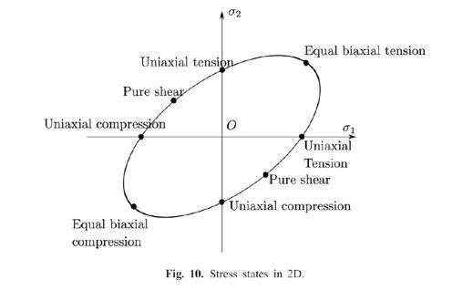
4.2 Molecular Dynamic Simulation
Molecular Dynamic(MD) Simulation:
For Pure Aluminum Case, total of 26 MD simulation is performed to generate Machine Learning Trainning Data as follows
Final Axial Loading Condition | Final Shear Loading Condition | Number of Simulation
50% Uniaxial Tension (X and Y direction) | 0%,+20%,-20% | 6
20% Uniaxial Compression (X and Y direction) | 0%,+20%,-20% | 6
50% Bi-axial Tension | 0%,+20%,-20% | 3
20% Bi-axial Compression | 0%,+20%,-20% | 3
20% Bi-axial Tension Compression(X Tension-Y Compression and vis-versa) | 0%,+20%,-20% | 6
No Axial Stress | +20%, -20% | 2
Total |  | 26
Dengpeng Huang et al. ,2020

Slide 14
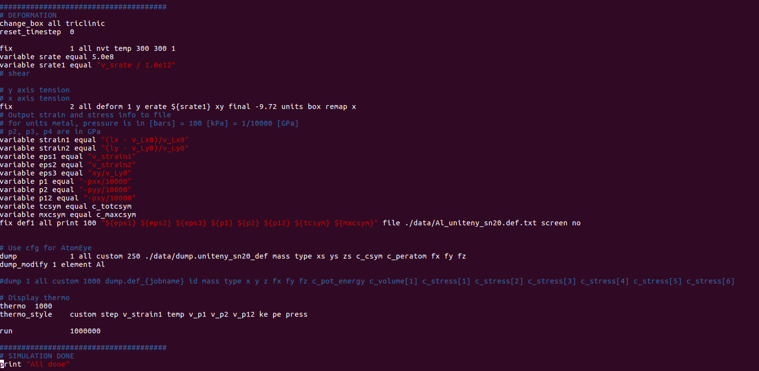
4.2 Molecular Dynamic Simulation(2)
LAMMPS Sample Scripts -----> Strain upto 50% Uniaxial Tensile deformation, 20% Shear Deformation

Slide 15
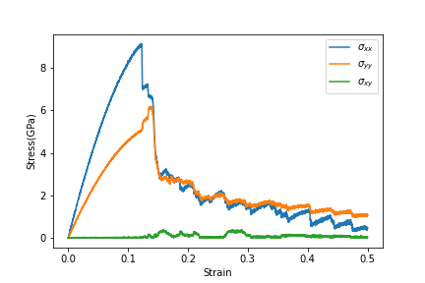
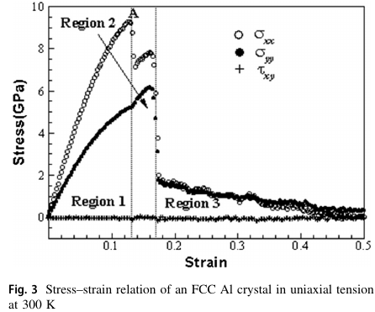
4.2 Molecular Dynamic Simulation(3)
MD Simulation Result Verification(50% Uniaxial tension at 0% shear)
Present Simulation Result
Xiao el al,2020

Slide 16
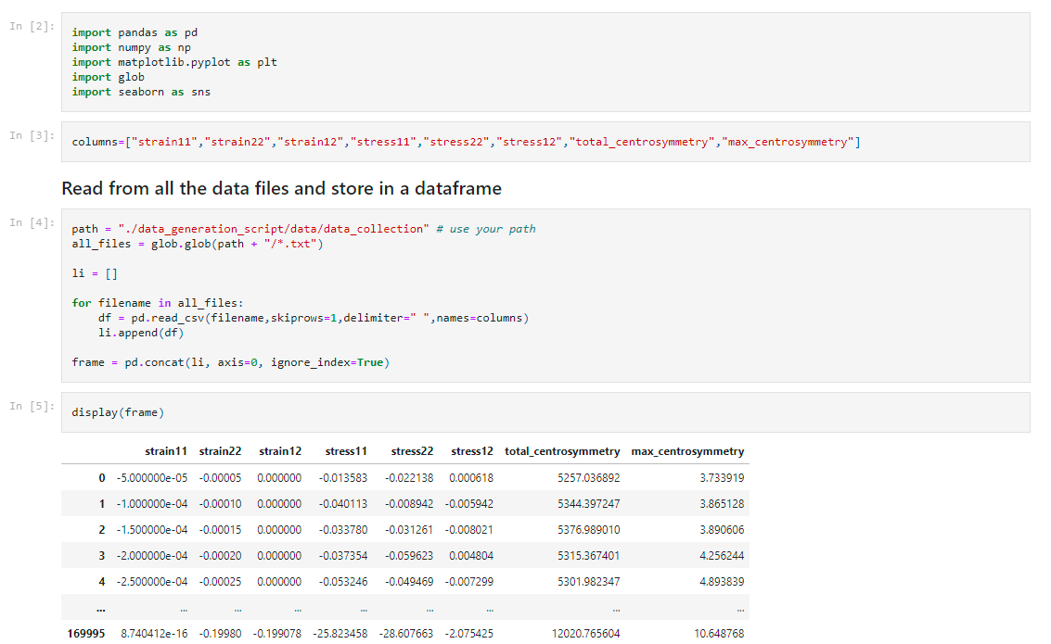
4.3 Database Creation

Slide 17
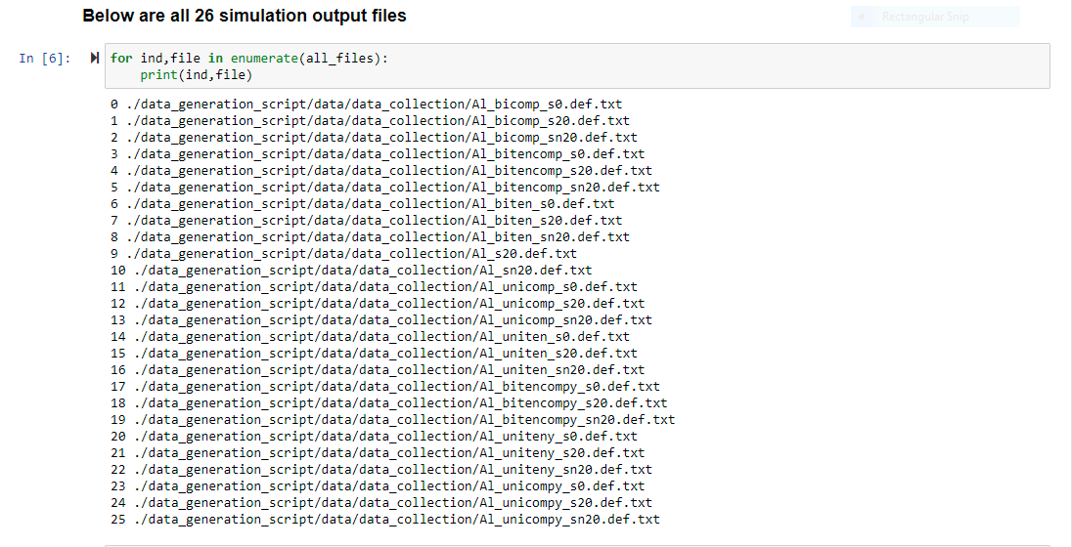
4.3 Database Creation(2)

Slide 18
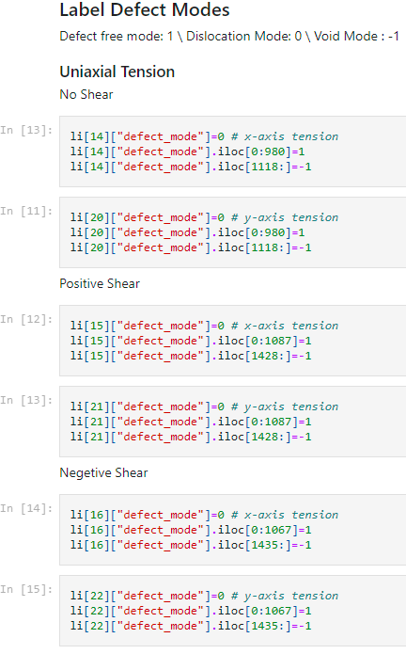
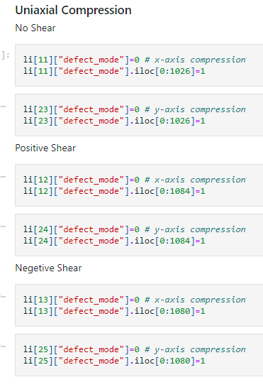
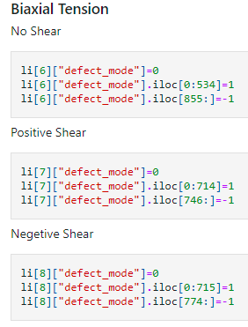
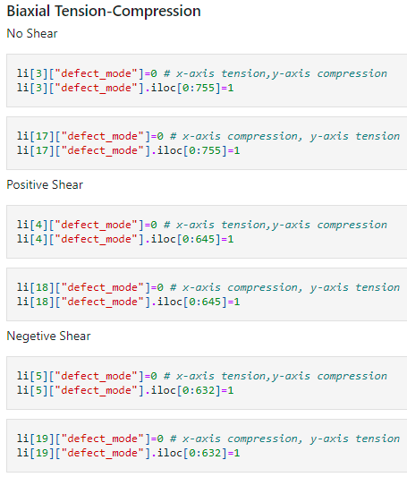
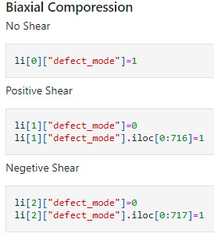
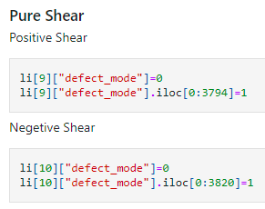
4.4 Labelling Defect Mode(2)
This defect labelling was done by visualization in OVITO and identifying defect free, dislocation and void modes. An Example is shown in the next page

Slide 19
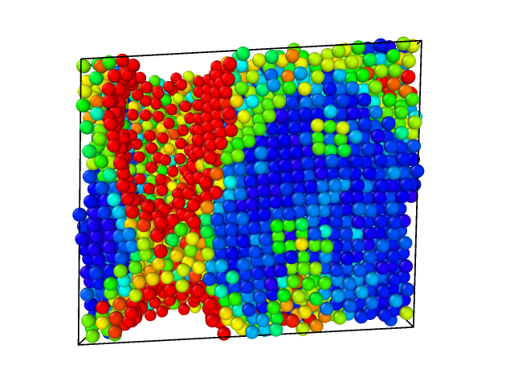
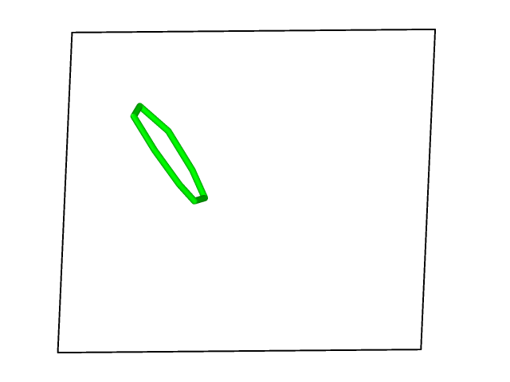
4.4 Labelling Defect Mode(3)
OVITO Visualization
Strain States before defect nucleation
Defect mode labelled: 1
Strain State at which dislocation nucleate and onwards
Defect mode labelled: 0
Strain State at which void nucleate and onwards
Defect mode labelled: -1

Slide 20
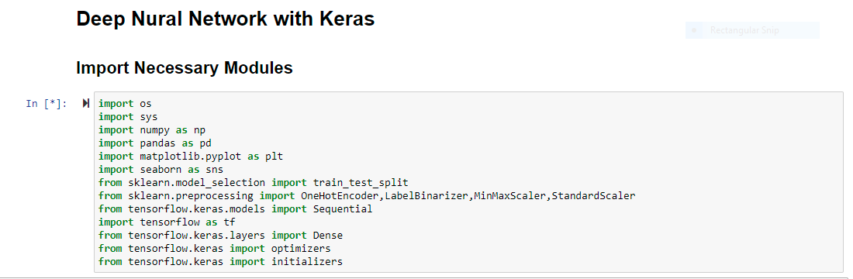
4.5 Training Machine Learning Model

Slide 21
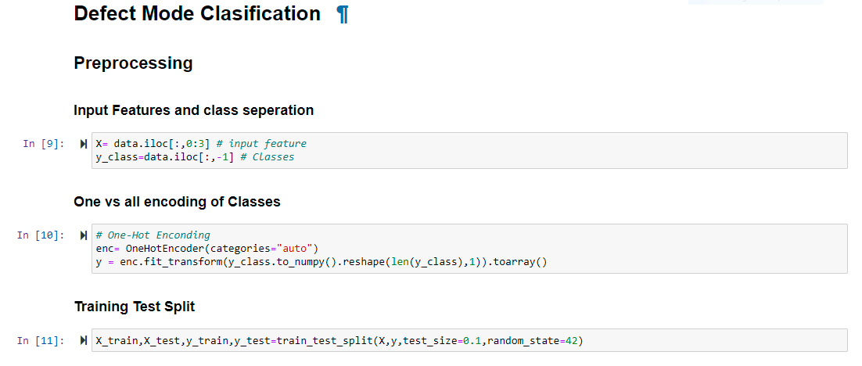
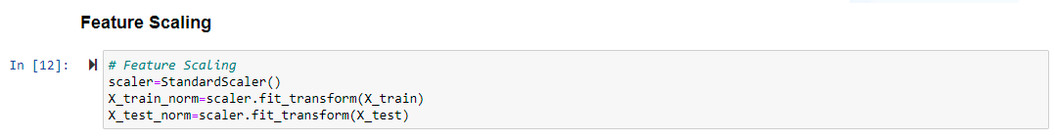
4.5.1 Defect Classification Model

Slide 22
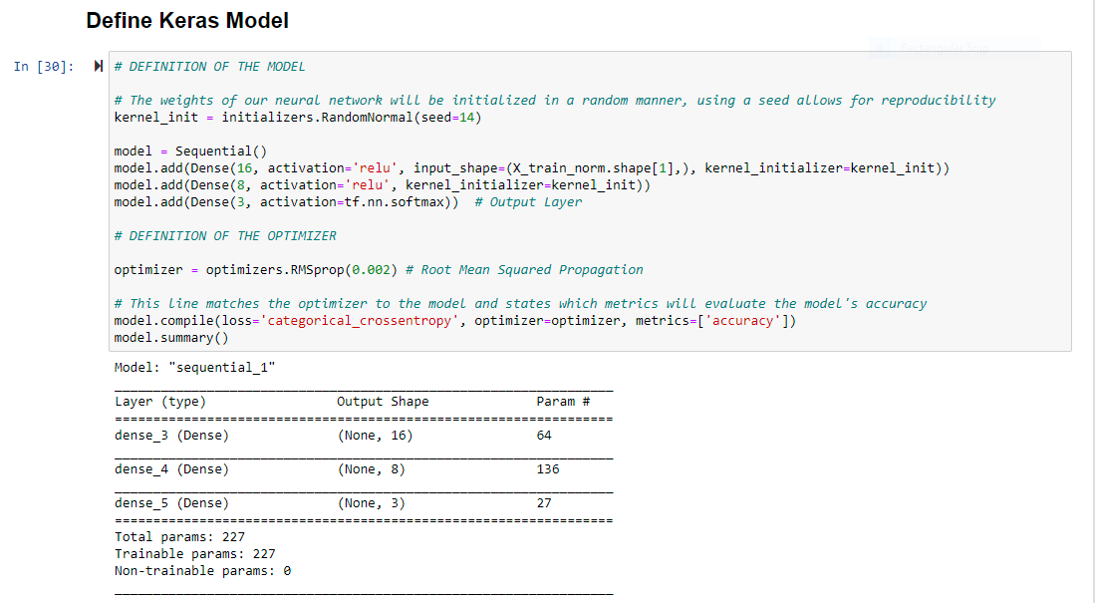
4.5.1 Defect Classification Model(2)

Slide 23
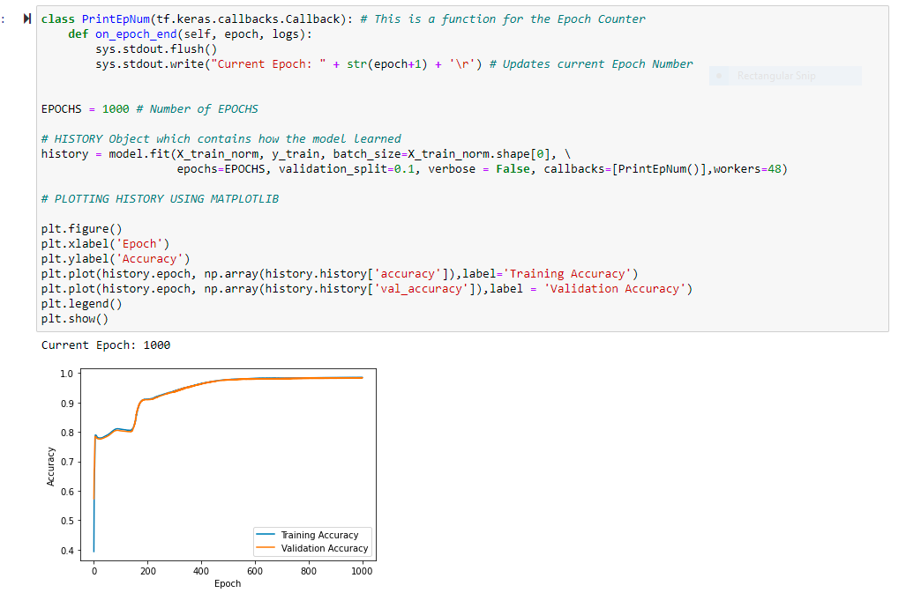
4.5.1 Defect Classification Model(3)

Slide 24
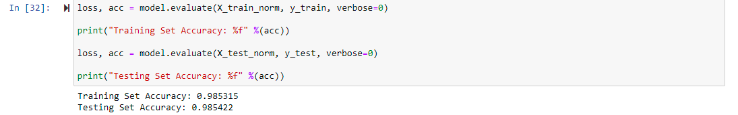






4.5.1 Defect Classification Model(3)

Slide 25

4.5.2 Stress Regression Model

Slide 26

4.5.2 Stress Regression Model

Slide 27

4.5.2 Stress Regression Model

Slide 28







4.5.2 Stress Regression Model

Slide 29
4.6 Implementation of ML Machines in FEA
An opensource Finite Element(FE) Solver Code_Aster has been proposed to implement the Molecular Dynamics Learned Machines through an external interface for custmized contitutive equation called "MFront"

Slide 30




5.0 Key Questions and Challenges
1. The defect mode prediction from the classification model reported in (Xiao el al,2020) is not consistent in the shear direction

Slide 31
5.0 Key Questions and Challenges
2. Implementation of frame invariance into the Machine Learning Model
3. The database created from the MD simulation result needs to be optimized for better training of ML model. Some data will be much more important than the others. For example, for classification model, data point closer to the decision boundaries are much more important than the other.
4. For the 1D inclusion ie; Al-CNT, Orientation of the CNT will also need to be incorporate into the learning model
5. Molecular Dynamics Simulation stress results has dependency on the strain rate applied. This affect needs to be closely looked into.
6. The interatomic potential of the inclusion and interface needs to be examined closely as, this parameter controls the atomistic information passed to the continuum.

